Slide 1
AI assistant for Requirements
The Next Generation Requirements Solution by GenAI

Slide 2
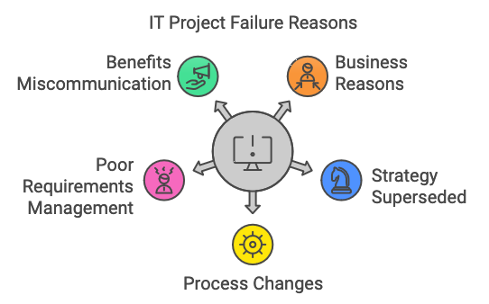
Problem
Based on a seven year long research of companies across the European Union, John McManus and Trevor Wood-Harper list the following as the top five key reasons why IT projects fail:
Business reasons
Business strategy superseded
Business processes change (poor alignment)
Poor requirements management
Business benefits not clearly communicated or overstated
《Impact Mapping: Making a big impact with software products and projects》
Notes:
Paper: 《Understanding the Sources of Information Systems Project Failure》

Slide 3
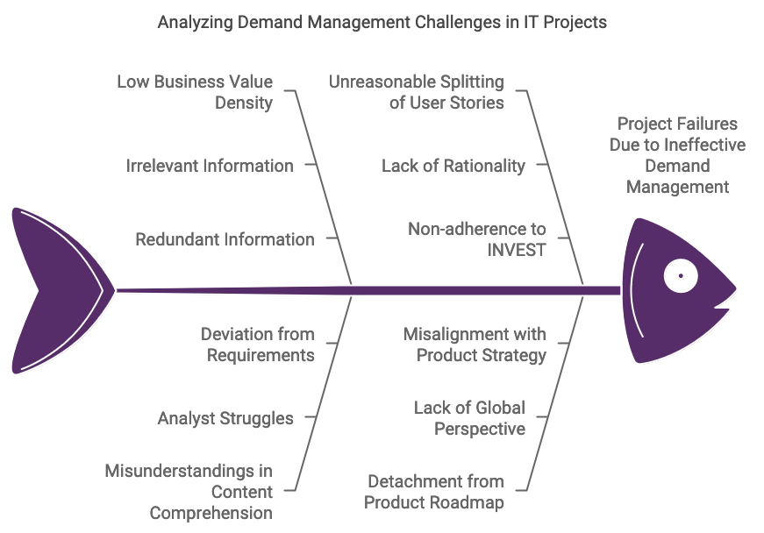
Why

Slide 4
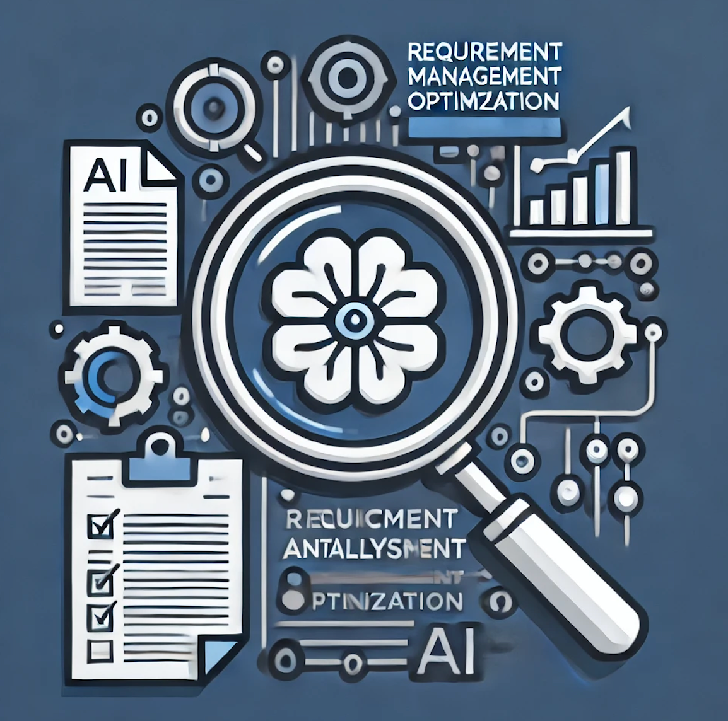
AI Demand Management Optimization Tool for Requirements
Core Features:
Intelligent Analysis: AI-driven extraction of high-value business information.
INVEST User Stories: Automated generation of high-quality user stories.
Communication Questions: Key questions to improve BA-client alignment.
Acceptance Criteria: Auto-generated criteria to reduce development risks.
User Story Map: Unified view of requirements and strategy.
Integrate with JIRA/WIKI etc.
Requirements Base ( business assets )

Slide 5
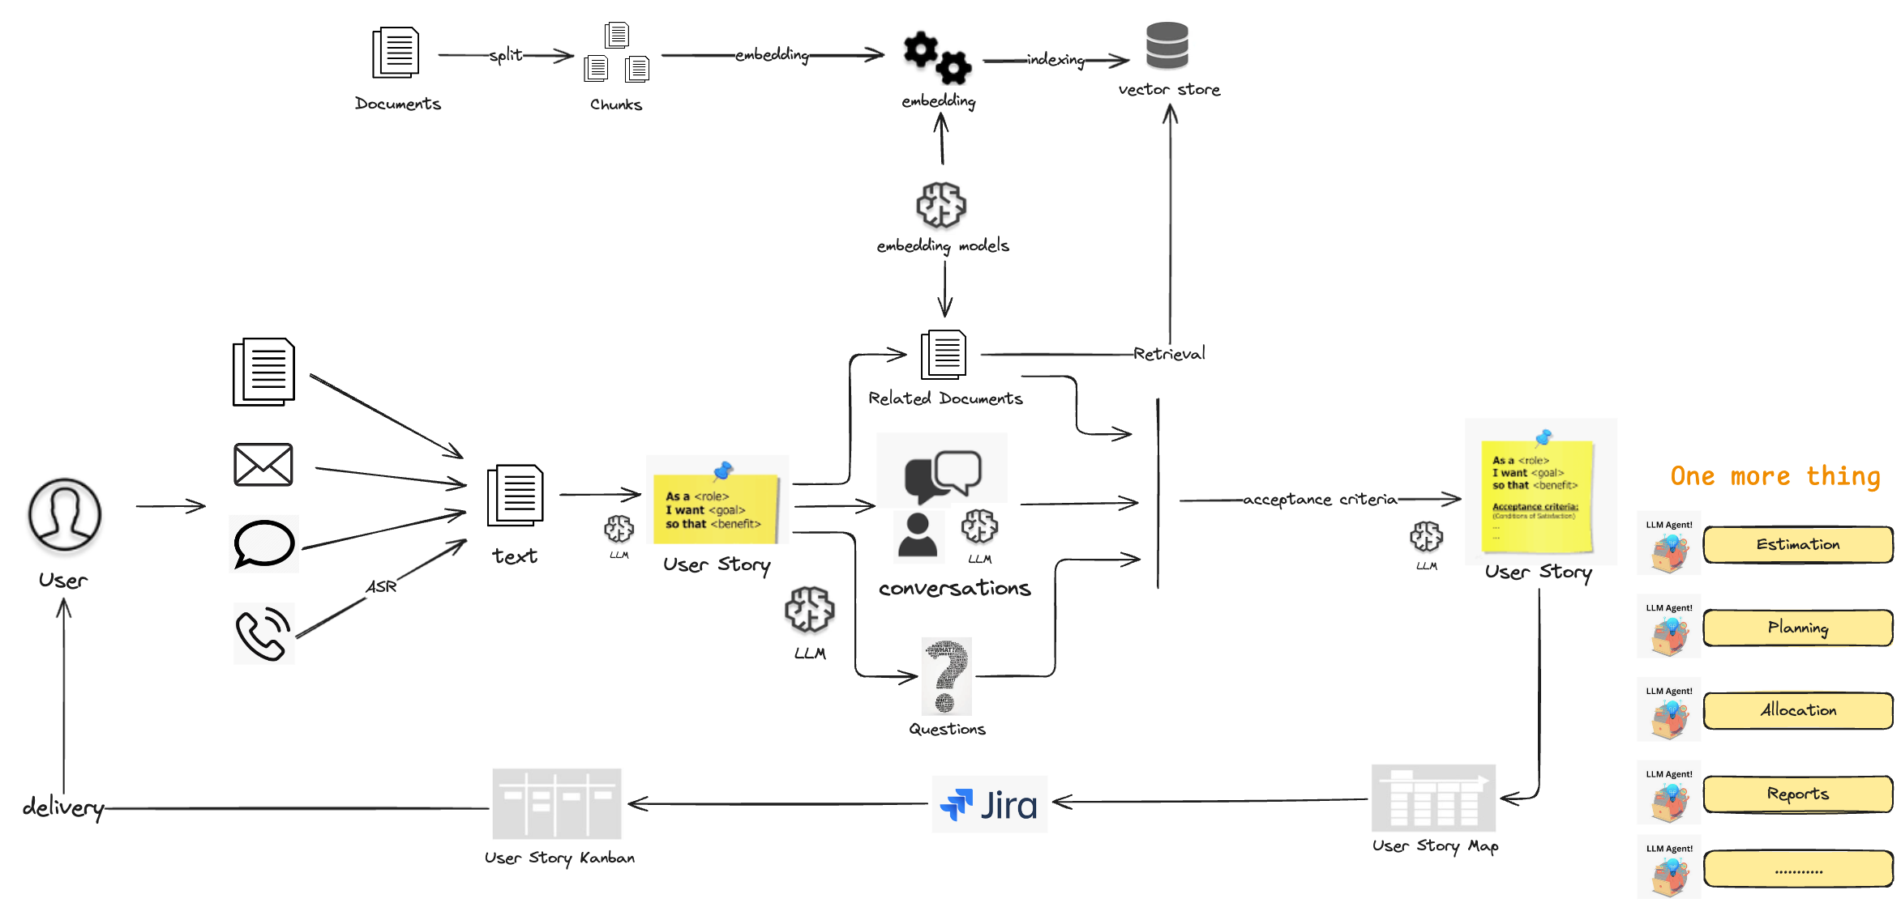
Architecture
Notes:
One more thing moment: coordinates multiple intelligent agents for collaborate effectively in future

Slide 6
DEMO
User Cases
Generate User Stories via any input text by LLM
User Story Map
Retrieve related documents by LLM
Retrieve similar user stories ( Prototype )
Generate key-questions by LLM
Conversations ( RAG by LLM )
Generate acceptance criteria by LLM
Create jira ticket
User Story kanban

Slide 7
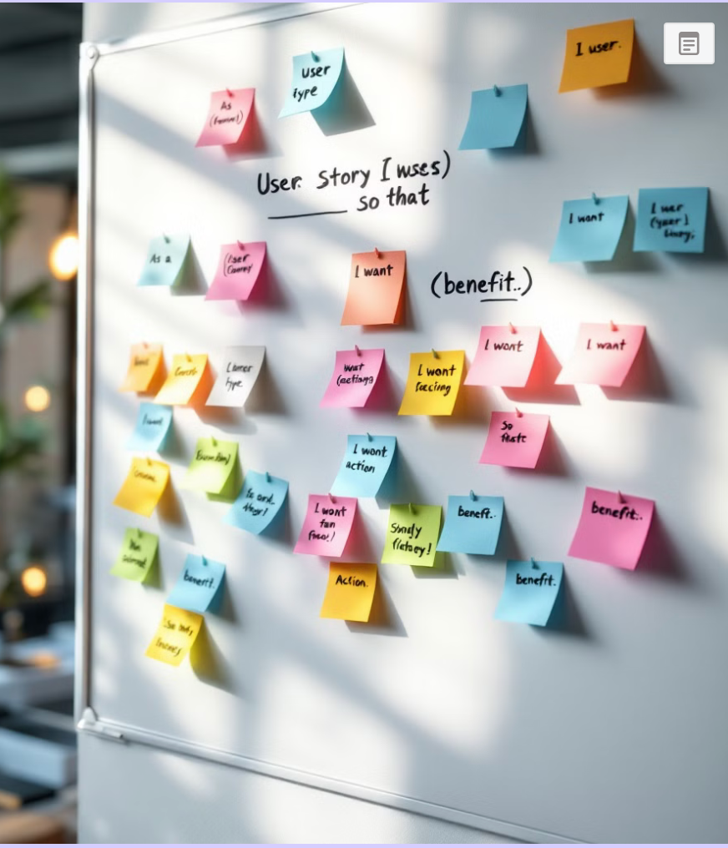
User Stories: Crafting User-Centric Requirements
User stories are a powerful tool in agile development, helping teams create software that truly meets user needs.
Key Takeaways
Value-Driven: Keeps the development process centered on delivering user value.
Adaptability: Supports iterative development and changing requirements.
Improved Communication: Facilitates alignment and collaboration across teams.

Slide 8
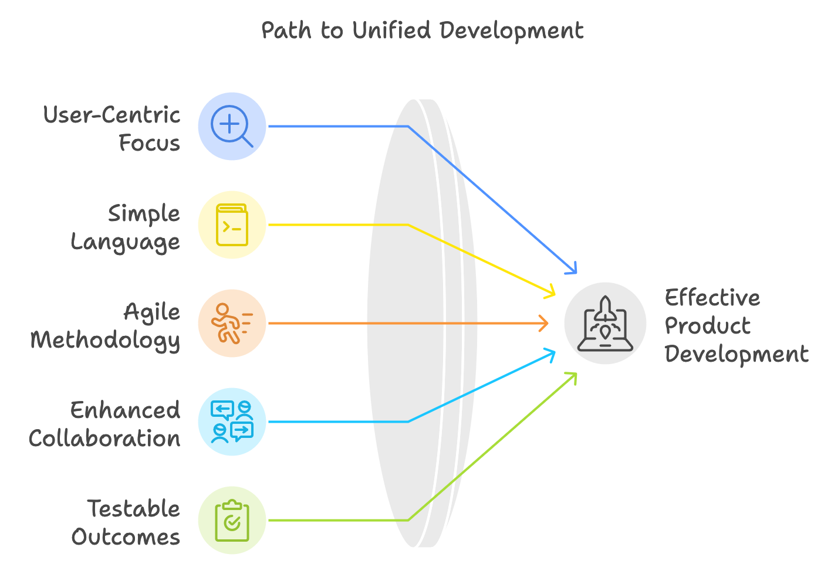
Advantages of User Stories
User-Centric: Focuses on user needs, ensuring development aligns with business value.
Simple and Clear: Uses non-technical language for easy understanding by all stakeholders.
Agile-Friendly: Enables decomposition and prioritization for quick iterations.
Enhances Collaboration: Encourages discussions among teams, users, and stakeholders.
Testable: Provides clear acceptance criteria to verify outcomes.

Slide 9

User Story Mapping
A User Story Map is a visual representation of user stories arranged by user activities and priorities. It provides a holistic view of the product from the user's perspective.
Key Takeaways
User-Focused: Keeps development aligned with user goals and pain points.
Strategic Planning: Guides roadmap creation and milestone setting.
Team Alignment: Ensures shared understanding across stakeholders.

Slide 10
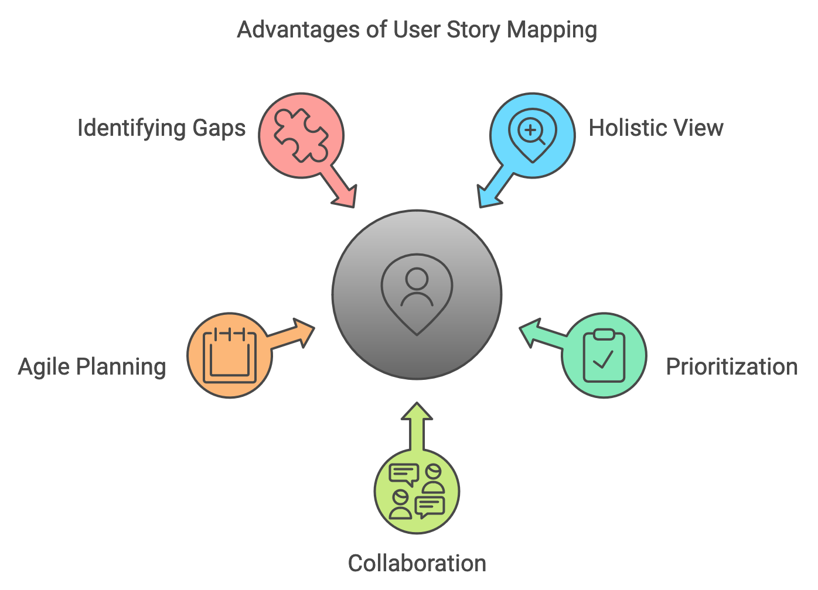
Advantages of User Story Mapping
Holistic View: Offers a clear overview of the product's user journey and features.
Prioritization: Helps identify the most critical stories for MVP (Minimum Viable Product).
Collaboration: Encourages team discussion and alignment on user needs and product goals.
Agile Planning: Facilitates sprint planning and backlog refinement with a focus on user value.
Identifying Gaps: Reveals missing stories or features in the user flow.

Slide 11
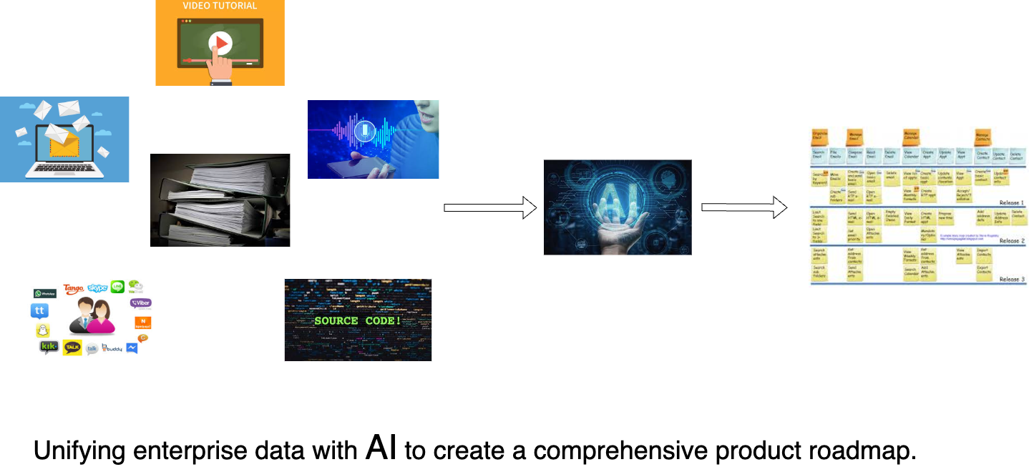
Big Picture

Slide 12


Project Plan
Phase 1 MVP Initial MVP product development
Phase 2 Customer Project Development of a customer project with a knowledge base
Phase 3 Expansion Expansion to more customer projects with knowledge and requirements base
Phase 4 Multi-Agents Coordinates multiple intelligent agents for collaborate effectively
2025 Q1
2025 Q2
2025 Q3
One more thing moment

Slide 13
Thank you

